Slide 1
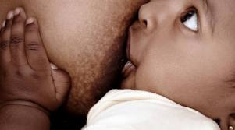
The Baby-Friendly Hospital Initiative
Lisa Judge, MD

Slide 2
Healthy People
(US Dept Health and Human Services)
Proportion of infants who are Breastfed… | US (%) CDC NIS ‘15-16 | Michigan (%) CDC NIS ‘15-16 | 2020 target (%)
Ever | 82.5 | 75.9 | 81.9
At 6 months | 55.3 | 48.3 | 60.6
At 12 months | 33.7 | 30.7 | 34.1
Exclusive BF through 3 months | 46.6 | 44.5 | 46.2
Exclusive BF through 6 months | 24.9 | 22.6 | 25.5
Notes:
Healthy People serves as the foundation for prevention efforts across the U.S. Department of Health and Human Services (HHS). Healthy People supports HHS efforts to create a healthier Nation: tobacco and drug use, HIV prevention, chronic disease, obesity, healthcare-associated infections, etc.
NIS = National Immunization Survey performed in 2013

Slide 3
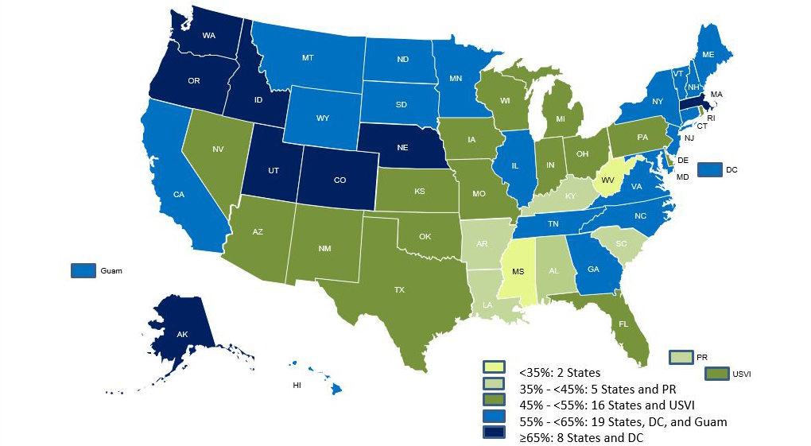
Percentage of Infants Breastfed at 6 Months
(CDC, 2014 Data)

Slide 4
Healthy People 2020 Goals, cont.
 | Current | Target
MICH-23: Reduce the proportion of breastfed newborns who receive formula supplementation within the first 2 days of life. (CDC NIS 2015-16) | 15.5% | 14.2%
MICH-24: Increase the proportion of live births that occur in facilities that provide recommended care for lactating mothers and their babies. (BF hospitals as of June 2016) | 18.3% | 8.1%
Notes:
TJC Perinatal Core Measure

Slide 5
Risk Factors for Breastfeeding (CDC NIS ‘15-16)
Demographic | Ever Breastfed (%) | Breastfed at 6 mo (%) | Breastfed at 12 mo (%)
Healthy People 2020 target | 81.9 | 60.6 | 34.1
US | 82.5 | 55.3 | 33.7
Hispanic | 84.8 | 52.5 | 31.7
Black | 68 | 41.5 | 21.5
HS grad or less | 72.9 | 40.9 | 22.9
Less than HS grad | 73.3 | 42.4 | 26.6
Unmarried | 72.5 | 37.2 | 21.1
WIC (participating) | 75.5 | 42.4 | 24.6
WIC (eligible, not participating) | 83.4 | 60.0 | 39.5

Slide 6

The Joint Commission
(TJC)
Perinatal Care Core Measures
  Exclusive breastmilk feeding (PC-05)
    Mandatory measure in January 2014 for hospitals with >1100 del/yr
    An outcome measure that reflects use of best hospital practices that support BF (e.g. Ten Steps)
    Def: “a newborn receiving only breast milk and no other liquids or solids except for drops or syrups consisting of vitamins, minerals, or medicines.”
    Breastmilk feedings = breastfeeding, expressed mother’s milk, or donor human milk
Core measures will be tied to reimbursement!

Slide 7
TJC Exclusive Breastfeeding Perinatal Care Core Measure
Calculation: # term singleton NBs fed only BM in hosp
    # term singleton NBs dischgd from hosp
Newborns excluded from denominator
  Ever admitted to NICU
  Infant galactosemia, other metabolic diseases
  NB died in hospital
  LOS >120 days
  Gestational age <37 wks
Newborns NOT excluded from denominator
  Maternal contraindications to breastfeeding
  Mother requests formula
  Excessive weight loss
Expected frequency of medically indicated supplementation in healthy term newborns: 10-15%

Slide 8
THE DECISION TO BREASTFEED
    78% of women decide their infant feeding plan before conception or during the first trimester
Decision influenced by
  Significant other:
    71% of feeding decisions influenced by infant’s father
  Family, friends
    29% of feeding decisions influenced by maternal grandmother
  Society
  Physician recommendation
  Formula marketing
  Media
  Work

Slide 9
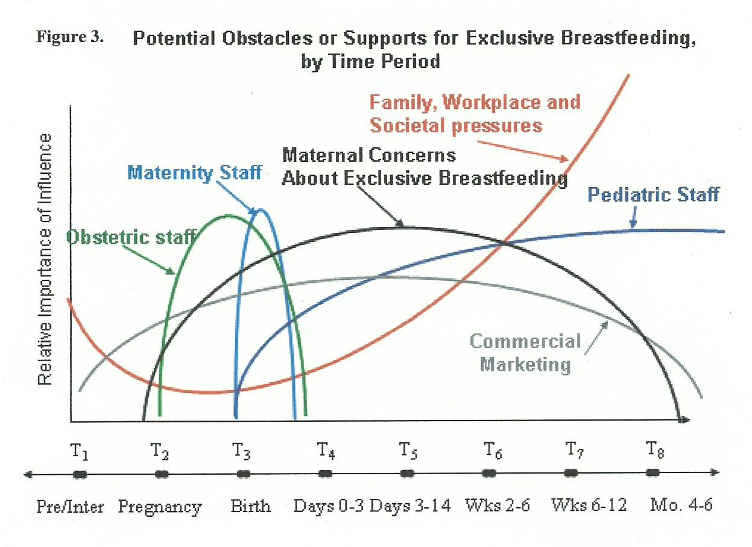
INFLUENCES ON THE DECISION TO BREASTFEED
Notes:
Importance of BF-friendly practice
“The closet full of formula”

Slide 10
WHEN IS BREASTFEEDING CONTRAINDICATED?
Maternal Conditions
  Maternal HIV infection (when formula available and safe)
  Maternal Human t-lymphotrophic virus (HTLV) type I or II infection
  Substance abuse (not in treatment program)
  Alcohol abuse
  Current maternal radiation therapy
  Active, untreated TB (mother should pump)
  Active, untreated varicella (mother should pump)
  Active HSV with breast lesions (mother should pump)
  Maternal medications (very few)
Notes:
Alcohol use: Occas, limited use may be ok
Avoid BF for at least 2 hrs after 1-2 drinks; no need to express and discard

Slide 11
WHEN IS BREASTFEEDING CONTRAINDICATED?
Infant conditions
  Inborn errors of metabolism
    Galactosemia
    Maple syrup urine disease
    PKU (some BF may be possible)

Slide 12
WHEN IS BREASTFEEDING NOT CONTRAINDICATED?
Maternal Hepatitis A, B, C
Maternal methadone/Subutex/Suboxone use as part of a treatment program
Most maternal illnesses (colds, flu)
  Babies benefit from immune response/protection mother is generating
After oral radiologic contrast; check with reliable source for BF compatibility

Slide 13
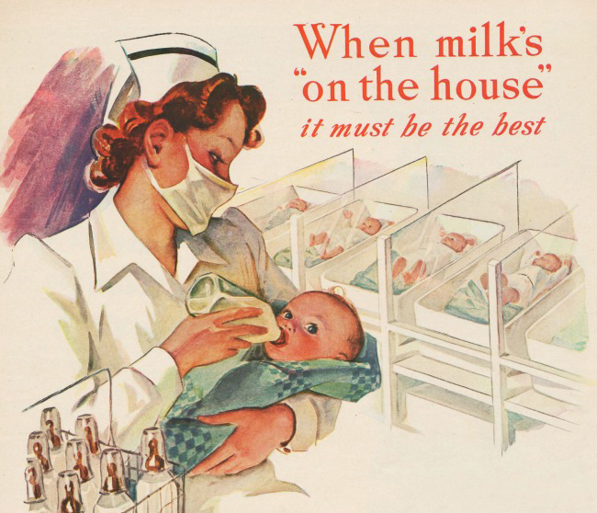
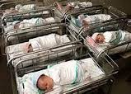
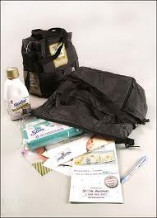
DECLINING BREASTFEEDING RATES IN THE 1900s
Influenced by multiple factors
  Societal
  Economic
  Marketing practices by formula companies initially targeted
    Hospitals
    Physicians
    Nurses
Formula seen as equivalent nutrition to breast milk instead of emergency feeding

Slide 14

The Code
1970s
  Birth rates in industrialized nations tapering off
  Formula companies shift advertising and product promotion to 3rd world countries (Nestle) leading to dramatic increases in infant mortality rates
1981 – WHO/UNICEF respond
Notes:
The CODE outlines the responsibilities of governments, health-care systems, and workers, and of the companies that market or manufacture breastmilk substitutes.
The Code represents the collective will of the member states of the UN and so carries substantial political and moral weight.
A Baby-Friendly hospital must abide by the tenets of the code.

Slide 15
International Code of Marketing of Breastmilk Substitutes: THE CODE
No advertising of infant formula
No free samples or supplies
No promotion of products through health care facilities; no free or low cost formula
No contact between marketing personnel and moms
No gifts or personal samples to health workers
Each country decides how/if they will adopt the code
  65 countries have made the code legislation
  US: no action
Notes:
Set up ethical marketing standards for the promotion and sale of formula, bottles, nipples, other infant foods.
No more free formula. No formula company-sponsored lunches. The hospital must pay a fair market value for their formula. Receipts of formula purchases must be shown to BF-USA site assessors.

Slide 16

The Baby-Friendly™ Hospital Initiative
(BFHI)
Sponsored by WHO and UNICEF, in use worldwide; launched in 1991
BFHI promotes, protects, and supports breastfeeding through the ‘Ten Steps to Successful Breastfeeding for Hospitals.’
Requires that parents be fully informed about the health hazards of unnecessary or improper use of infant formula.
Emphasizes the safe preparation, storage, and feeding of formula

Slide 17
WHAT IS A BABY-FRIENDLY HOSPITAL?
The internationally defined term 'Baby-Friendly' may be used only by maternity services that have passed external assessment according to the Global Criteria for the BFHI.

Slide 18
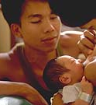
Where are ‘Baby-Friendly’ Hospitals?
>20,000 hospitals in 171 countries
507 hospitals in the US (4/7/18)
  Today, 24% of annual births occur in B-F facilities!!
  Healthy People 2020 goal: 8.1%
14 hospitals in Michigan (4/3/18)
Beaumont Hospital (Grosse Pointe); Covenant Medical Center (Saginaw); HF Allegiance Health (Jackson); HF Hospital (Detroit); HF West Bloomfield (West Bloomfield); Saint Mary’s Hospital (Grand Rapids); Providence Park Hospitals (Novi and Southfield); Sparrow Hospital (Lansing); Spectrum Health (Grand Rapids); Spectrum Health (Greenville); St. John Hospital (Detroit); St. John Hospital (Warren); St. Joseph Mercy (Pontiac).
Notes:
Allegiance, Spectrum/Butterworth, Spectrum Greenville, Sparrow, HF West Bloomfield, St. John x 4, St. Joe’s Oakland, Covenant, Beaumont Grosse Pointe

Slide 19
TEN STEPS TO SUCCESSFUL BREASTFEEDING FOR HOSPITALS
Have a written breastfeeding policy that is routinely communicated to all staff
Train all healthcare staff in skills necessary to implement the policy
Inform all pregnant women about the benefits and management of breastfeeding prenatally
Help mothers initiate breastfeeding within 1 hr of birth
Show mothers how to breastfeed and how to maintain lactation even if they are separated from their infants

Slide 20
TEN STEPS TO SUCCESSFUL BREASTFEEDING FOR HOSPITALS
Give newborn infant no food or drink other than breast-milk unless medically indicated
Practice rooming-in 24 hrs/day
Encourage breastfeeding on demand
Give no pacifiers or artificial nipples to breastfeeding infants
Foster the establishment of breastfeeding support groups and refer mothers to them on discharge from the hospital or clinic

Slide 21
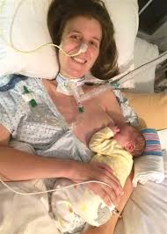
STEP 1: The policy
(2)
Infant Feeding Policy
  For Women’s and Children’s Division
Hospital-wide Policy
  For other areas of hospital that may encounter a breastfeeding mother
    Radiology
    OR/Recovery Room
    Anesthesia
    Med/Surg floors
    Pharmacy
    ER
    Social work
    Dietary
    Environmental services
  Includes contact info for LCs, resources for medication compatibility during nursing

Slide 22

STEP 2: Staff Education
Maternity care nursing staff (L&D, M/B unit, NICU, Peds)
  15 hrs didactic education, 5 hours clinical/bedside education
Providers – physicians, advanced practice practitioners
  3 hrs BF education + annual updates

Slide 23
Breastfeeding and the Use of Human Milk
AAP Policy Statement, 2012
“Research and practice in the 5 years since publication of the last AAP policy statement have reinforced the conclusion that breastfeeding and the use of human milk confer unique nutritional and non-nutritional benefits to the infant and the mother and, in turn, optimize infant, child, and adult health as well as child growth and development. Recently, published evidence-based studies have confirmed and quantitated the risks of not breastfeeding. Thus, infant feeding should not be considered as a lifestyle choice but rather as a basic health issue. As such, the pediatrician’s role in advocating and supporting proper breastfeeding practices is essential and vital for the achievement of this preferred public health goal.”

Slide 24
WHO Growth Charts
Released in 2006
Based on longitudinal reference group of children demonstrating optimal/ideal growth patterns
  BF is the recommended standard for infant feeding
  Children predominately breastfed for at least 4 months and still breastfeeding at 12 months
  6 countries throughout the world (incl US)
Use up to 2 yrs of age (then CDC growth charts)
Charts for weight, length, weight for length, head circumference available
Online training course for WHO Growth Charts
http://www.cdc.gov/nccdphp/dnpao/growthcharts/who/index.htm
Notes:
CDC growth charts based on typical growth – not necessarily ideal growth

Slide 25
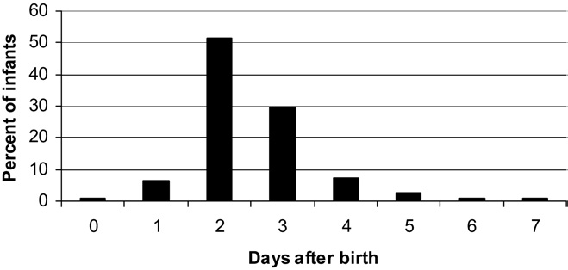
NORMAL NEWBORN WEIGHT LOSS
    Full term babies should start to gain weight by the 3rd-5th day of life
    Avg weight loss in BF babies: ~6%; BF/formula 2.3%, formula fed 1.2%
    Most BF infants regain birthweight by ~7-10 days after birth.
    Infants who lose >/= 8-10% of birthweight need careful evaluation and follow-up
    Assess all parameters of adequate intake (not just weight)
  Figure. Days after birth when weight loss nadir reached at a US Baby-Friendly hospital.
Notes:
Weight gain starts when mother’s milk comes in.

Slide 26
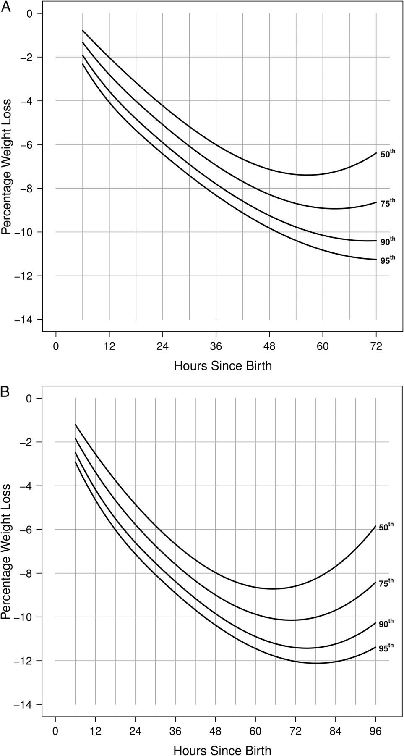

Estimated percentile curves of percent weight loss by time after birth for vaginal and Cesarean deliveries
Vaginal birth
Cesarean birth
http://www.newbornweight.org
Valerie J. Flaherman et al. Pediatrics 2015;135:e16-e23
Notes:
A, Estimated percentile curves of percent weight loss by time after birth for vaginal deliveries. B, Estimated percentile curves of percent weight loss by time after birth for Cesarean deliveries. ****Normative data to inform clinical decision-making***
All infant exclusively breastfed!! Not clear how many hospitals were designated BF.
For 161 471 term, singleton neonates born at ≥36 weeks’ gestation at Northern California Kaiser Permanente hospitals in 2009–2013, data were extracted from the birth hospitalization regarding delivery mode, race/ethnicity, feeding type, and weights from electronic records. Quantile regression was used to create nomograms stratified by delivery mode that estimated percentiles of weight loss as a function of time among exclusively breastfed neonates. Weights measured subsequent to any nonbreastmilk feeding were excluded.
Differential weight loss by delivery mode was evident 6 hours after delivery and persisted over time. Almost 5% of vaginally delivered newborns and >10% of those delivered by cesarean had lost ≥10% of their birth weight 48 hours after delivery. By 72 hours, >25% of newborns delivered by cesarean had lost ≥10% of their birth weight.
Weight loss differs substantially by mode of delivery.
Weight loss >/= 10% is common and occurs earlier in the postnatal course than previously thought.

Slide 27
STEP 3: Prenatal Education
Important!!!!
  Educational programs about breastfeeding are the most effective single intervention in improving BF initiation and duration. (Guise, Ann Fam Medicine 2003)
It is not the length of the ‘lecture’ on BF but the # of times the topic is introduced and supported

Slide 28


PRENATAL BREASTFEEDING EDUCATION
Required content:
  Benefits of BF
  Latch, position
  Hospital practices that support BF
    No pacifiers, bottles
    Avoidance of supplements
    Rooming-in
    Feed on demand
    Skin to skin
  Importance of exclusive breastfeeding for 6 mos and the introduction of complementary foods
Identify a SUPPORT PERSON!

Slide 29
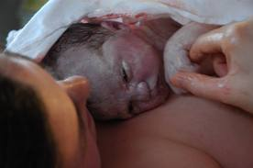
STEP 4: Help mothers initiate breastfeeding within the first hour of birth: Skin to Skin (S2S)
Why skin to skin?
  Mothers
    Facilitates BF initiation
    Enhanced milk production
    Bonding
    Analgesia
    Calming
    Regulates temperature
  Newborn
    More contented, less crying
    Better subsequent latch
    Promotes physiologic stability (HR, breathing)/smoother transition
    Higher blood sugars
    Warmth

Slide 30
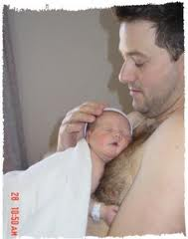


S2S
When?
  Immediately after birth unless medical problems (whether formula or breastfeeding)
    As soon as the mother is able to respond following C/S birth, ideally in the OR
  In the days/weeks after birth
Who?
  Fathers, other family members

Slide 31
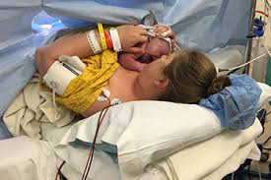
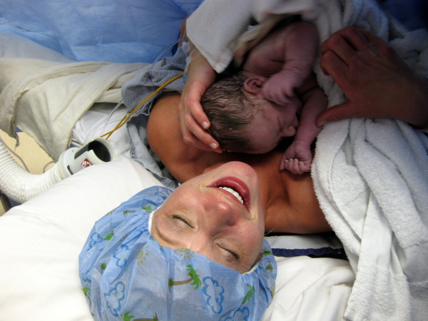
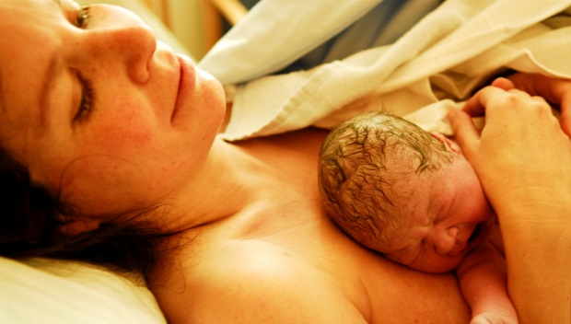
S2S
How?
  Vag delivery: Baby placed supine on mother’s bare chest, dried quickly, evaluated, placed prone. Both covered with warm blanket
  Cesarean delivery: assessment on warmer, placed on mother by 5 min.
  Delay weight, measurements, Vit K injection, eye prophylaxis until after first feeding
  Follow safe sleep recommendations
How long?
  As long as the mother wishes
  At least until after the first BF
Notes:
If mother getting sleepy baby should be put in separate sleep space (crib) acc to AAP recommendations

Slide 32
STEP 5: Show mothers how to breastfeed and maintain lactation if they are separated from their infants
Education also pertains to formula feeding families
Assessments and education are provided by nursing staff
Lactation consultants are available to assist with problems

Slide 33


STEP 5: Required Education Content: BF
Within 3-6 hrs of birth: correct position and latch
Before discharge:
  Importance of exclusive breastfeeding
  How to maintain lactation for exclusive breastfeeding/breast milk for 6 mos
  Criteria to assess if infant is getting enough breast milk
  How to express (hand expression), handle, store breast milk
  How to sustain lactation if mother is separated from infant or will not be exclusively breastfeeding after discharge
    Pumping initiation (w/in 1 hour if separated immediately; no later than 6 hrs after birth)

Slide 34
STEP 5: Required Education Content: Formula
Provide written and verbal instructions
Safe preparation, handling, storage, feeding of infant formula
Powdered infant formula preparation, per CDC recommendations, required

Slide 35
Powdered Formula Preparation
“In most cases, it is safe to mix powdered infant formula following manufacturer’s instructions. But if your baby is very young (<3 months), was born prematurely, or has a weakened immune system, you may want to take extra precautions to protect against Cronobacter. Good hygiene, mixing the formula with water hot enough to kill germs, and safely storing formula can prevent growth of Cronobacter and other germs, like Salmonella ¹.” (CDC, 2017)
Powdered infant formula preparation (CDC, WHO):
  Boil water and allow to cool to no less than 158° F/70° C before pouring into a clean and sterilized feeding cup or bottle. To achieve this temperature, the water should be left for no more than 30 minutes after boiling. (5 minutes in Ann Arbor kitchen tests)
  Add powdered infant formula. Use the amount as instructed on the formula label.
Notes:
It usually occurs in the first days or weeks of life. Typically, CDC is informed of about 4-6 cases of sickness from Cronobacter in infants each year, but reporting isn't required.

Slide 36
STEP 6: Supplementation
Why should supplements be avoided unless medically necessary?
  Changes in gut flora and pH (formula)
  Health risks (formula)
  Decreases BF opportunities -> decr supply
  Implies equivalency of formula to breast milk (formula)
  Undermines mother’s confidence in BF
  Quality measure (TJC): reimbursement will be negatively impacted if formula supps used inappropriately
Expected frequency of medically indicated supplementation in healthy term newborns: 10-15%

Slide 37


INDICATIONS FOR SUPPLEMENTATION

Slide 38
INDICATIONS FOR SUPPLEMENTATION
  Maternal
    Delayed lactogenesis II (e.g. from retained placenta, primary glandular insufficiency [<5% women])
    Breast pathology or prior surgery
    Intolerable pain during feeds unrelieved by interventions

Slide 39
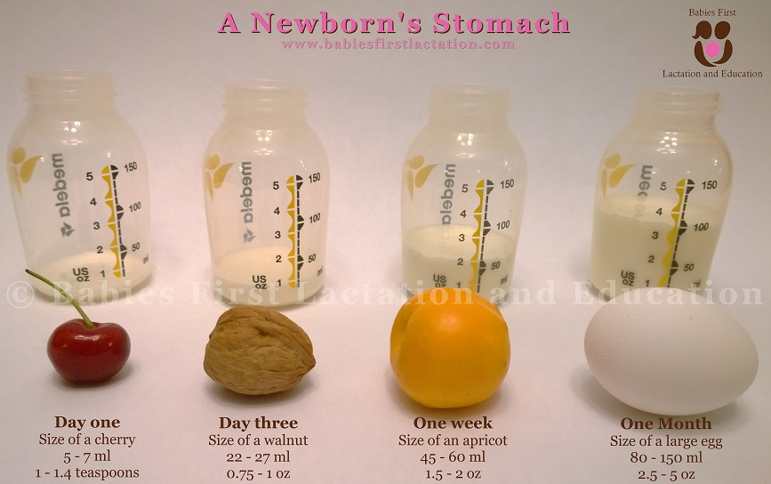
SUPPLEMENTS
SUBSTRATE
  Mother’s expressed breastmilk
  Donor breastmilk
  Standard formula
HOW MUCH?
  0-24 hrs: 2-10 ml/feed
  24-48 hrs: 5-15 ml/feed
  48-72 hrs: 15-30 ml/feed
  72-96 hrs: 30-60 ml/feed

Slide 40
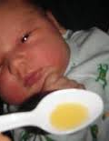
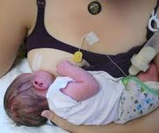
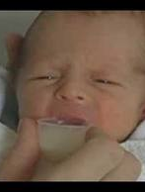
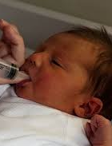
SUPPLEMENTS
Cup, spoon, syringe, supplemental
nursing system (SNS)
Bottles only if long-term
supplementation after dis-
charge anticipated
**Any baby discharged using supplements should have close, frequent follow-up with lactation consultants with the ultimate goal of ending supplements.**
Notes:
If infant not latching well prob won’t take bottle either. Latch very vulnerable. Use cup, SNS (not bottle)

Slide 41

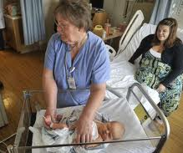
STEP 7: ROOMING-IN
  Benefits (for all families)
  Mother learns how to handle, comfort baby
  Mother learns feeding cues, responds to baby quickly
  Enables on-demand feeding
  Mother gets better rest
  Baby learns to recognize its mother
  Babies cry less
  SAFETY
  Less infection risk
Notes:
None of these benefits are specific to breastfeeding…they apply to formula fed infants/families as well.

Slide 42
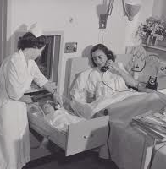
ROOMING-IN
  Baby and mother stay together
  Newborn screen, CCHD pulse oximetry screening, blood sugars, hearing screen, physical assessments all done in mother’s room (not circumcision)
  Safe sleep practices followed
  Staff record time infant out of room and why

Slide 43
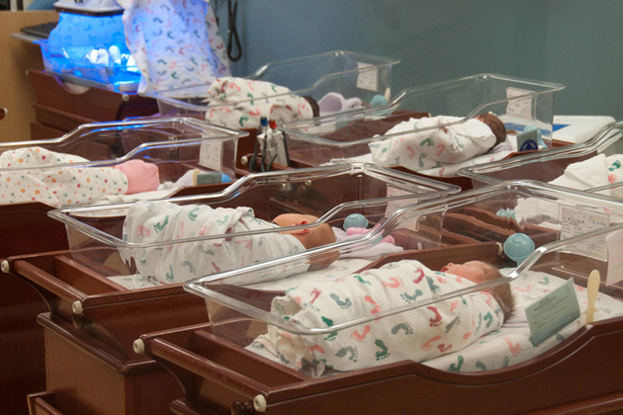
What if mother asks to have baby removed from room?
Parents re-educated about benefits of rooming-in
Encourage use of support person for baby while mom rests
If still insists, plan made with mother that baby will be brought back to room at first signs of hunger cues
Baby taken to ‘Newborn Treatment Room’

Slide 44

SAFETY PLAN
Maternal exhaustion and/or pain medications may make it unsafe for baby to be in room alone with mother.
SUPPORT PERSON!
Notes:
Support person important!!

Slide 45
STEP 9: Avoid Pacifier and Artificial Nipple Use
Why?
  Pacifiers given in response to feeding cues provide no nutrition
  Interfere with cue-based feeding → delay in milk coming in, decreased supply
  Sucking mechanism different than with BF; may make it more difficult to attach to the breast
Avoid artificial nipples and pacifiers until mother’s milk supply is established (3-4 weeks).
Notes:
Keep the oral stimulus consistent

Slide 46
HOW DO WE AVOID ARTIFICIAL NIPPLES AND PACIFIERS?
Utilize alternative feeding methods for medically indicated supplements.
Pacifiers will not be stocked on M/B unit EXCEPT in treatment room for use during circumcision (w/ sucrose). In the NICU they are used for babies w/ drug withdrawal and preemies (non-nutritive sucking).
SIDS prevention: offer pacifier @ 3-4 wks.
Notes:
Pacifiers used during circs should be discarded before the infant leaves the circ room

Slide 47
STEP 10: Foster the establishment of breastfeeding support groups and refer mothers to them on discharge from the hospital or clinic
The Baby-Friendly Hospital Initiative recognizes the critical role breastfeeding support in the community plays after discharge from the hospital.
  An early post-discharge follow-up appointment with the pediatrician, family practitioner, or other pediatric care provider should be scheduled (w/in 2-4 days).
  Information about community-based breastfeeding support options is provided at the time of discharge AND when BF dyad re-enters hospital system w/ BF problem (e.g. ED)
    Breastfeeding support groups, WIC, telephone help lines, breastfeeding support within physician practices, lactation clinics, and individualized specialized resource persons.

Slide 48
BABY-FRIENDLY AND FORMULA
For mothers who make an informed decision to use formula, hospital staff
  Respect their decision
  Instruct parents on safe preparation and storage of infant formula
  Instruct parents about baby-led feeding, avoidance of over-feeding
  S2S, Rooming-in expected to facilitate bonding and recognition of feeding cues

Slide 49
The Baby-Friendly Site Assessment
Consists of
  Interviews will be conducted with staff in prenatal offices, L&D, M/B Unit, NICU, OB and pediatric providers, hospital administration
  Interviews with mothers
  Observation of deliveries
  Review of formula receipts
  Inspection of hospital for signs reflecting the commitment to support breastfeeding, lack of formula advertising in patient care areas
  Review of policies related to infant feeding
Assessors are looking for a change in culture and care practices that support breastfeeding and that these changes are reflected in the experience of the family!

Slide 50
Does the Baby-Friendly Hospital Initiative Increase Breastfeeding?
Promotion of Breastfeeding Intervention Trial (PROBIT)
  Mothers who gave birth at Baby-Friendly hospitals were more likely to
    Breastfeed exclusively at 3 months (43.3% vs 6.4%)
    Continue to breastfeed through 12 months (19.7% vs 11.4%)
    Kramer, JAMA, 2001

Slide 51
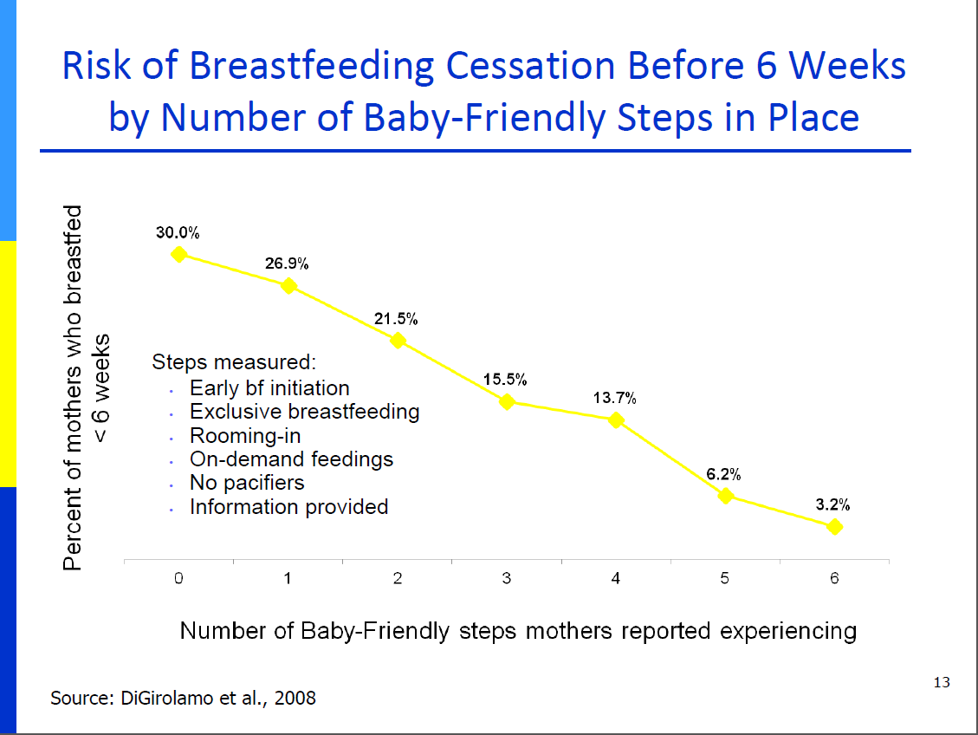
Does the Baby-Friendly Hospital Initiative Increase Breastfeeding?

Slide 52

QUESTIONS?

